Slide 1

Using Synthetic DNA to Archive Data
Thomas Heinis

Slide 2
Problems with Tape (and Storage in general)
“60% of archival data stored longer than 20 years” [SNIA]
Tape has a lifetime of 10-20 years - continuous data migration

Slide 3
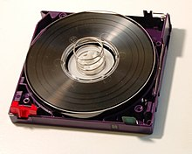
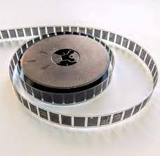
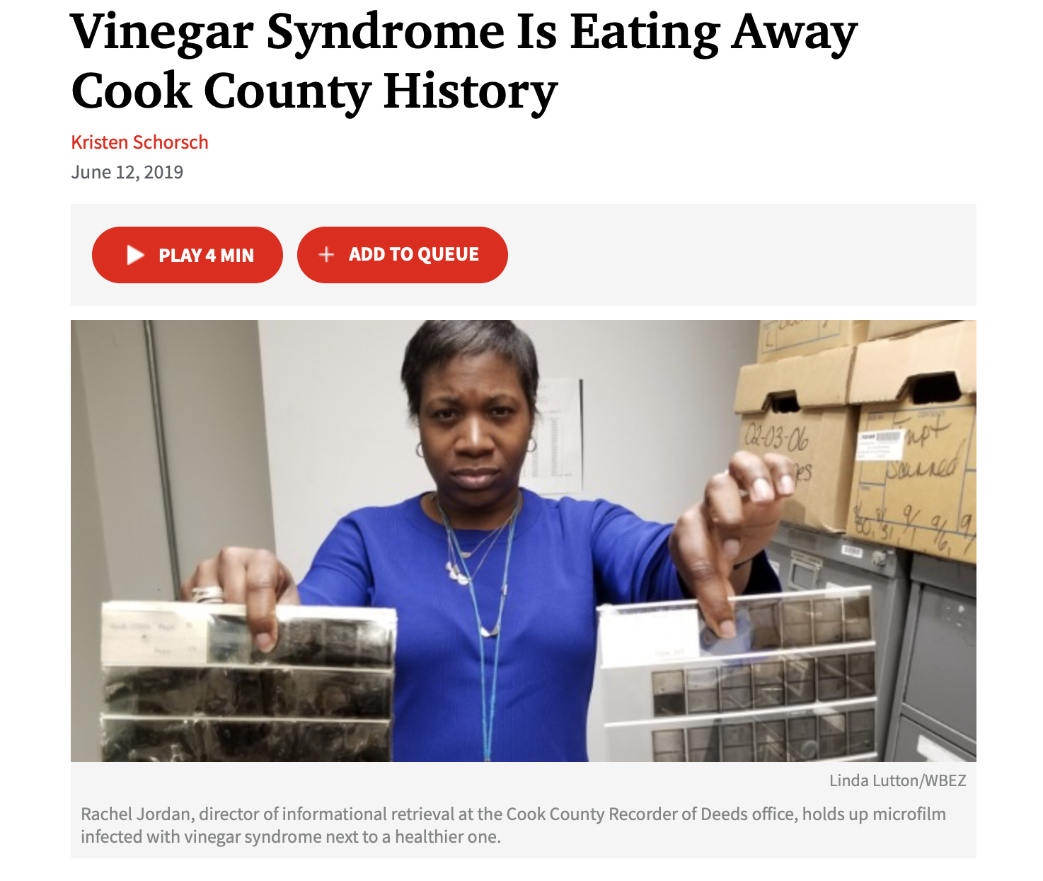
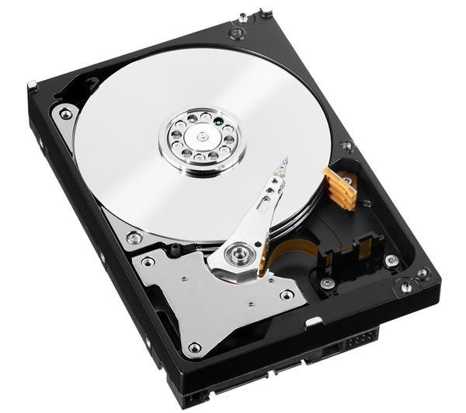
Current Solutions

Slide 4
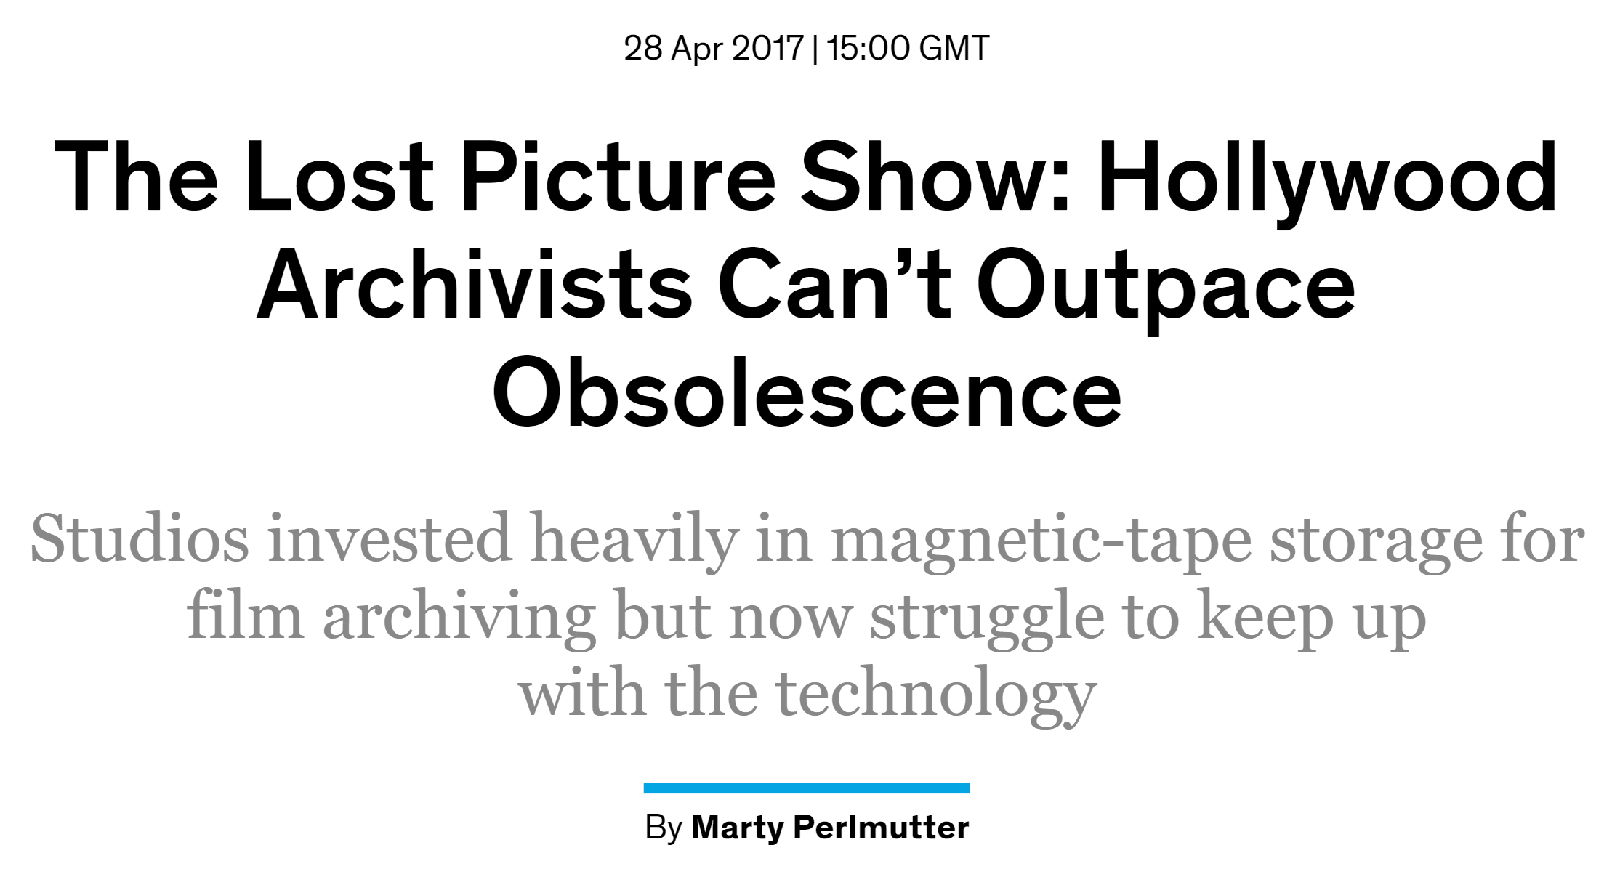
Net effect: Media Obsolescence
“There’s going to be a large dead period,” he told me, “from the late ’90s through 2020, where most media will be lost.”
Enterprise DBMS archives might soon face obsolescence too

Slide 5
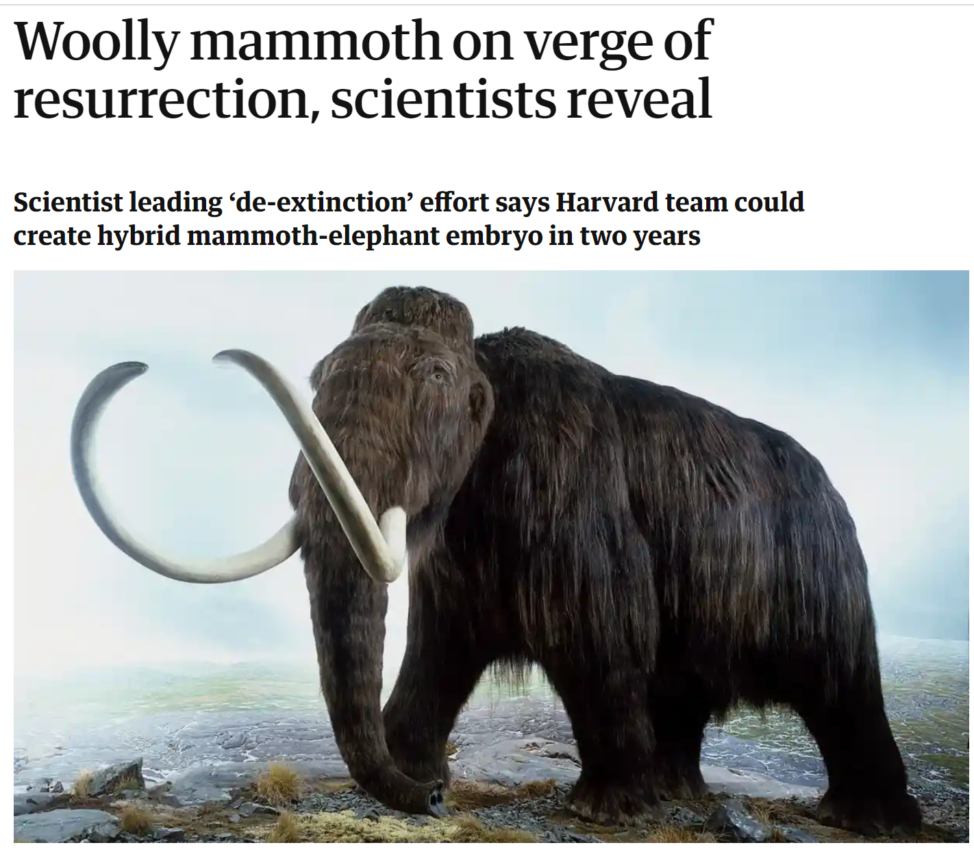

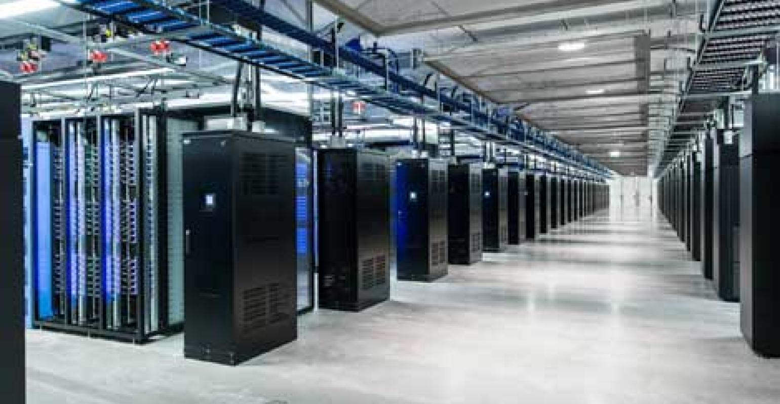
Why DNA?
Durable
Dense
All the world’s data in a teaspoon

Slide 6
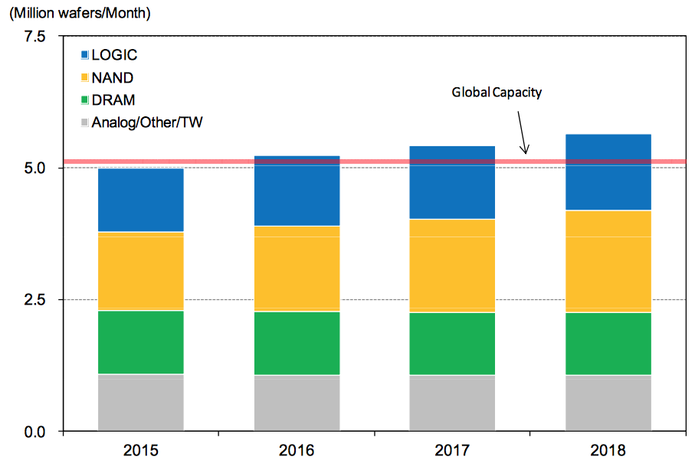

Why DNA?
Scarcity of Silicon Supply
Energy Efficiency

Slide 7
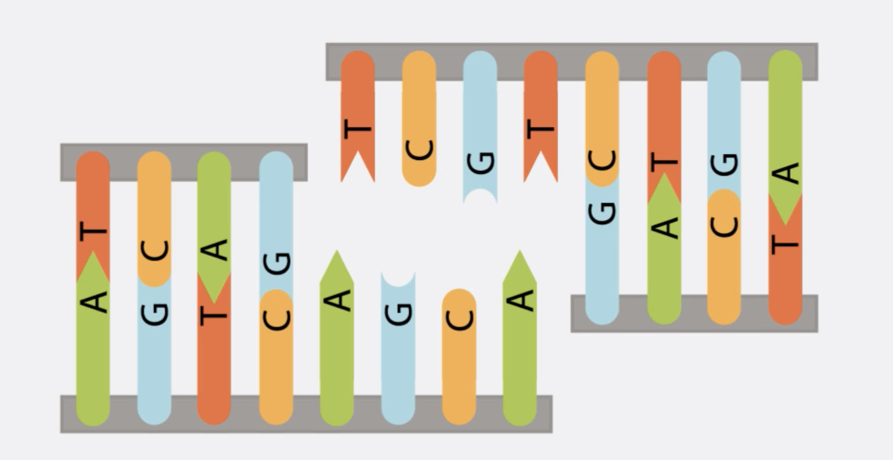
Why DNA?
Parallelism

Slide 8
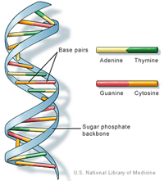
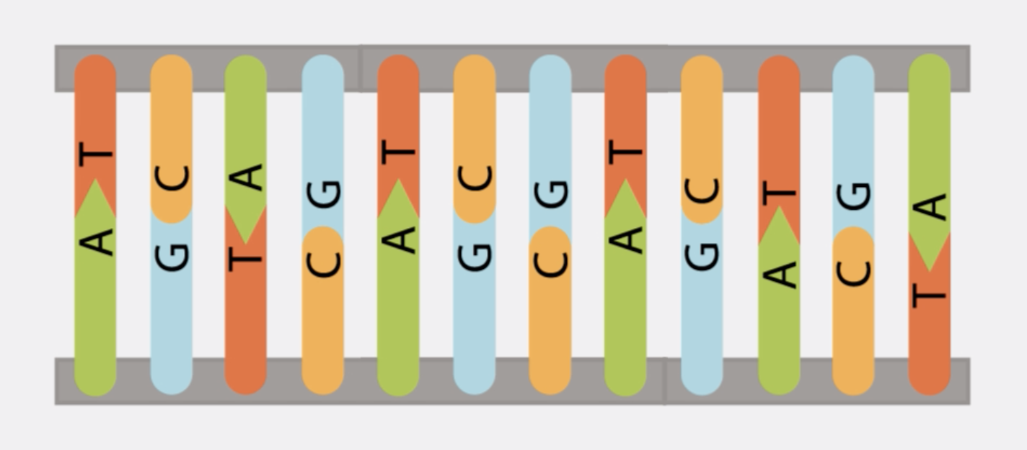
Deoxyribonucleic Acid (DNA)
Carrier of genetic instructions/information
Double, long chain of molecules called nucleotides
Four different nucleotides: A, T, C & G
Complementarity (A & T, C & G) provides stability

Slide 9
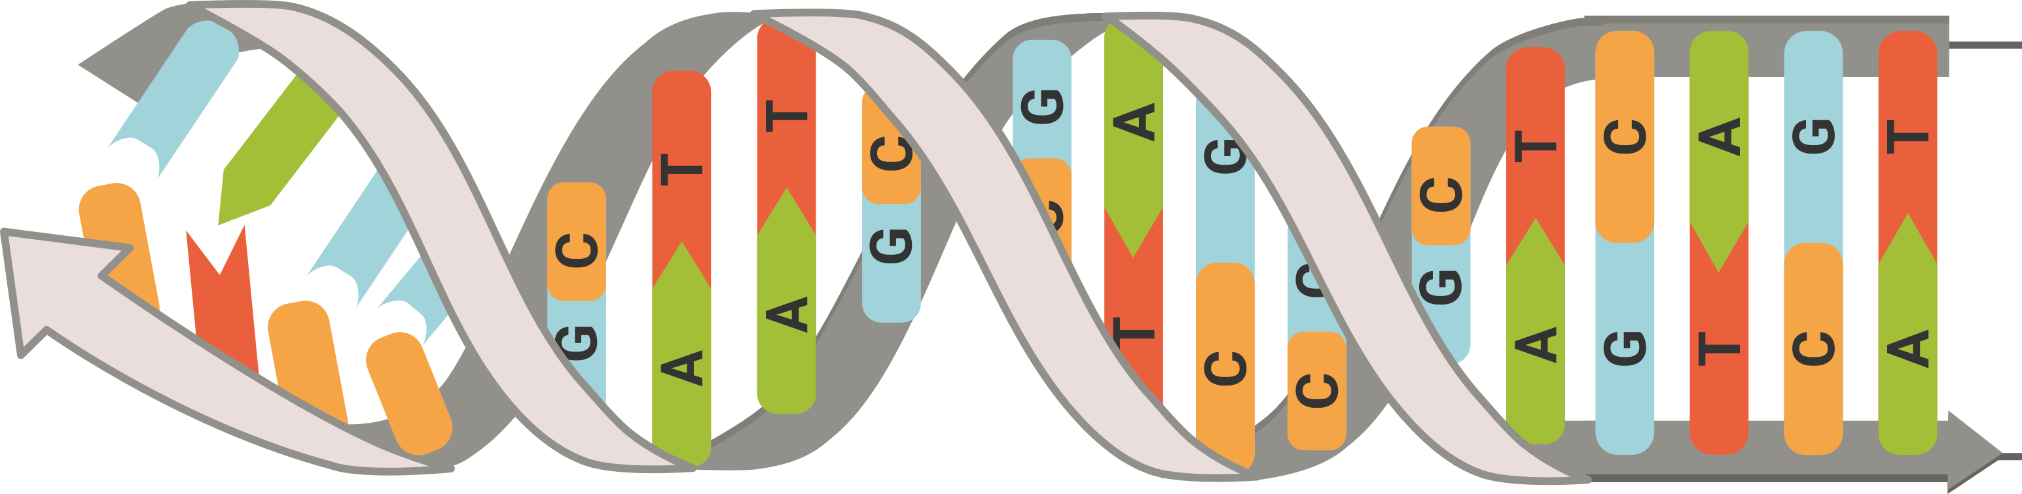
Storing Information in DNA
“Jane Adams, Oxenthorpe Rd, Puddleby”
DECODE
ENCODE
0101110101010
1111010100001
AtgcGAcAtgA
cTAgatCGataA
ATGCGAGATGA
CTAGATCGATAA
SEQUENCE
SYNTHESIZE
Notes:
To store meaningful amount, thousands of different sequences are needed

Slide 10
Encoding Information in DNA
Translate arbitrary data to nucleotides (A, T, C, G)
Goal: compact code! Minimize the number of nucleotides per bit. E.g.:
010101110101
00 → A
01 → T
10 → C
11 → G
010101110110
T
T
T
G
T
C

Slide 11
Encoding Information in DNA
Theory: 0.5 nucleotides per bit
Challenges:
  Biological constraints
  Error-prone synthesis & sequencing
  Sequence length is limited (~300 nucleotides)
Reality:
Typically, around 1 nucleotide per bit
AGG
CTCAGAT
AGATCTAATT
Identifier/Index
Error Correction Codes
Value/Payload

Slide 12
Status & Outlook

Slide 13
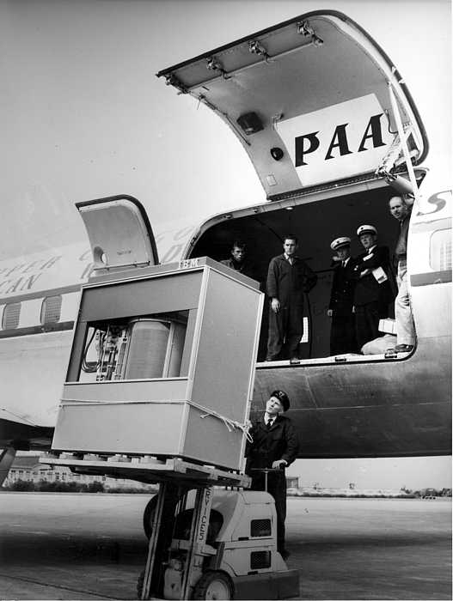
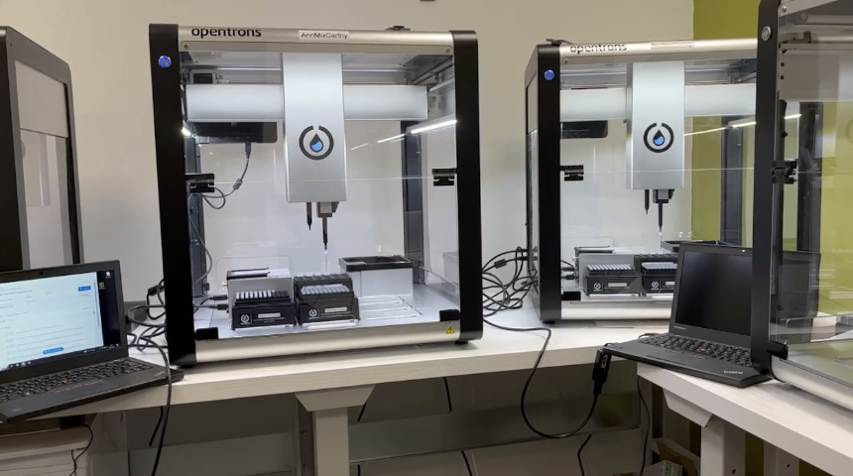
DNA Storage Today
Courtesy of Helixworks - https://www.helix.works/
Notes:
1956 Megabyte cost $10,000, or $88,000 in today's dollars. The IBM 305 was the size of two large fridges, weighed over a tonne and stored just 5MB of data
A 5MB hard disk drive from Apple cost $3,500 in 1981. That's $700,000 per gigabyte.10 Jul 2019
KB/s versus GB/s
.000 cents vs thousnads of dollars per GB

Slide 14
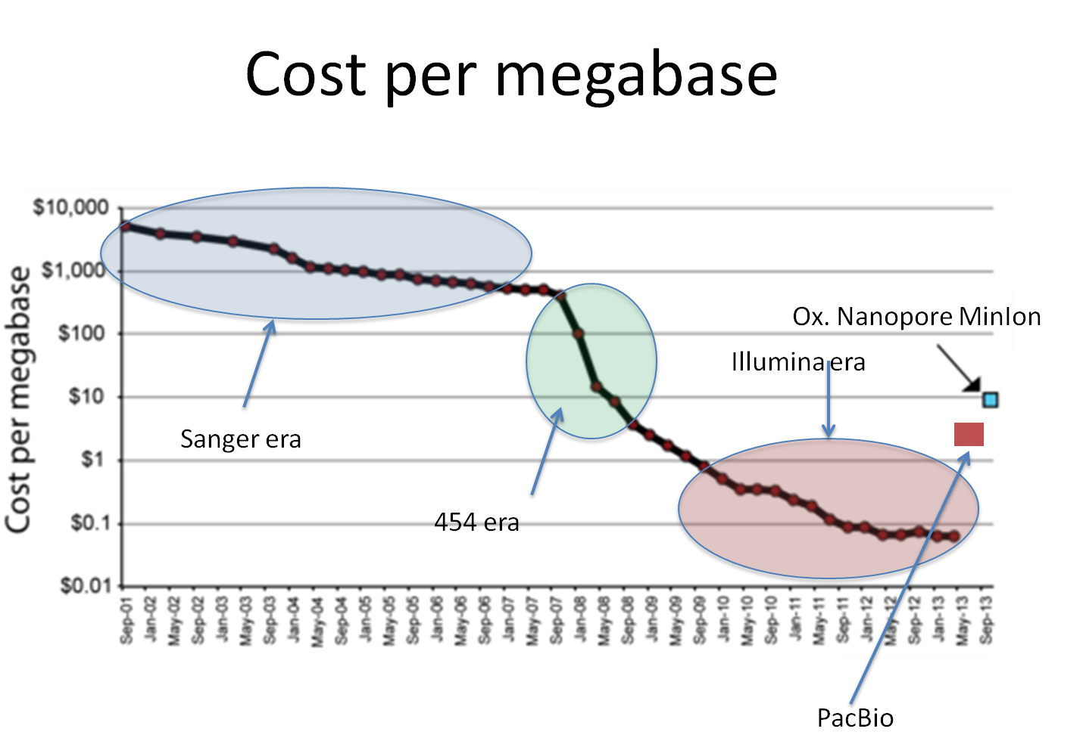
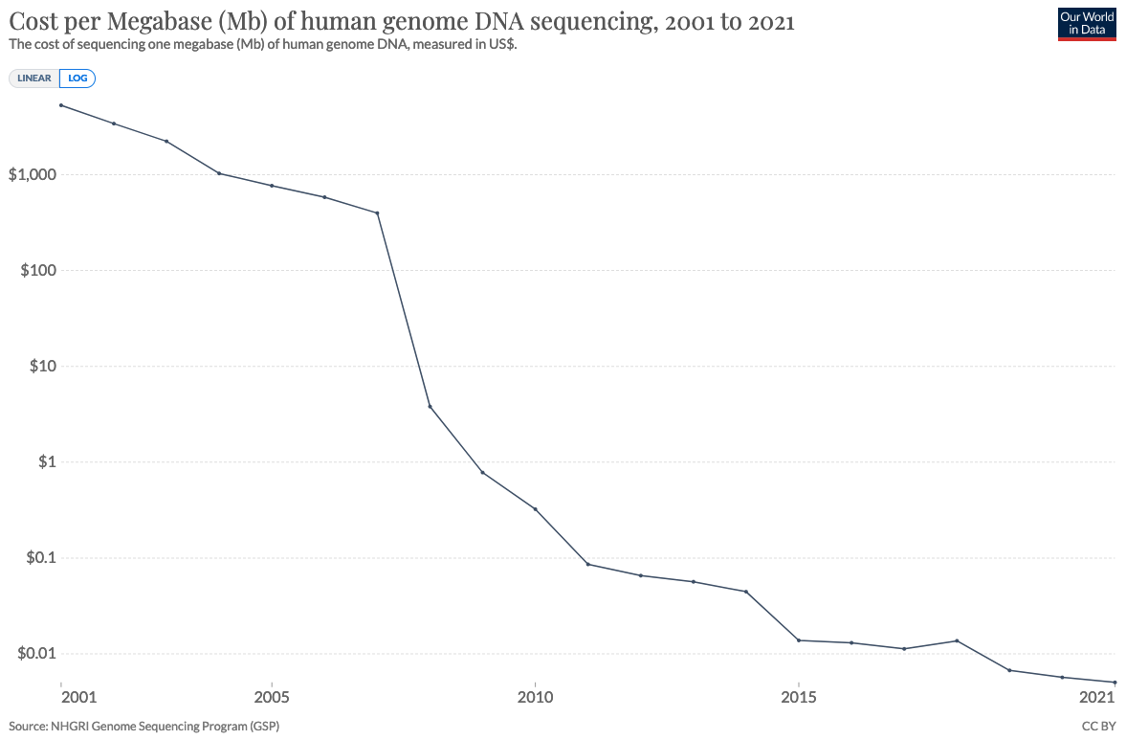
Trends Sequencing Cost
Solid-state nanopores will further lower cost of sequencing
Notes:
Single molecule
Long read
Publicly available through select community starting April 2014

Slide 15
Trends Synthesis
Synthesis cost (and speed) is major roadblock!
Notes:
USD 6.44 BN in 2022

Slide 16

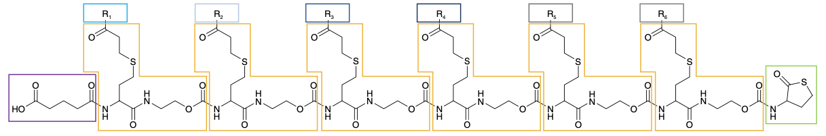
Tackling Write Cost
Novel synthesis techniques for DNA Storage:
  Tolerance for errors in DNA storage
  Longer sequences
  Expanded alphabets (Hachimoji synthesis: P, Z, B, S)
  Synthetic molecules
  DNA nanostructures

Slide 17
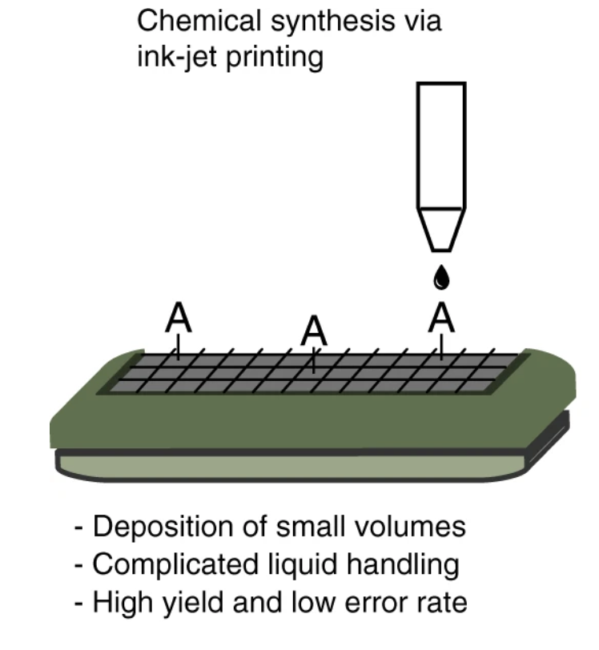
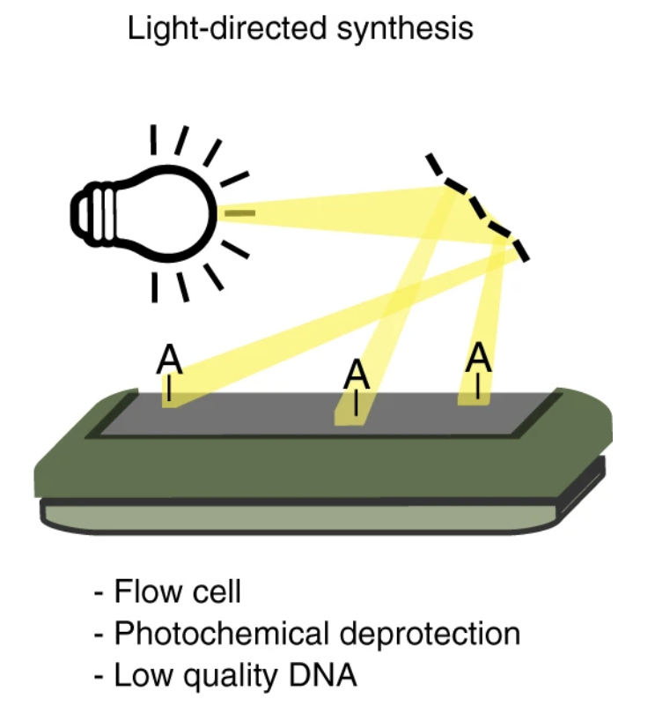
Scaling Writing
Reduce reagents, scale writing!
Light-directed synthesis
Ink-jet printing
Notes:
Twist & Agilent use left

Slide 18




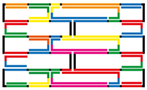

DNA Nanostructures
staple DNA strands
folded DNA origami
heat to 90C, cool to 20C over an hour
scaffold DNA strand
(M13mp18 bacteriophage virus)

Slide 19
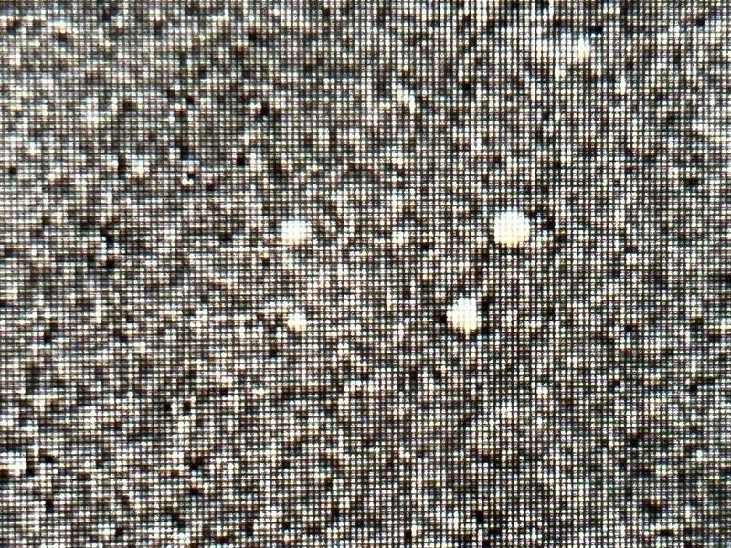
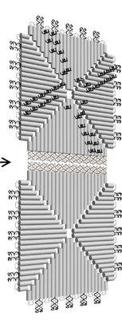
Status & Outlook
Proof of concept storing 58 bits per three-layer structure
Read out via AFM
Decoded using machine learning pipeline
Future work:
  Combine structures
  Incorporate error correction codes
  Optimize storage
  Optimize decoding pipeline

Slide 20

Writing to Nanostructures
Folding

Slide 21
Our Research Directions
Encoding
  Compact error correction codes for exotic synthesis approaches
Synthesis Cost:
  DNA nanostructures
  Imprecise synthesis
  Expanded alphabet (Hachimoji synthesis: P, Z, B, S)
Automation:
  Automate synthesis, storage and sequencing
Storage/packaging: wrap long DNA sequences
around synthetic histones
DNA

Slide 22
Conclusions
DNA offers huge potential for long-term data storage for hundreds of years
Scaling up write throughput and scaling down write cost are key and focus of research today
Not available tomorrow but ready to revolutionize data storage in 4-10 years!
More info on https://dnastorage.doc.ic.ac.uk/

