Slide 1
Machine Learning on Tiny Hardware
RAD
dasya.itu.dk
rad.itu.dk
Robert Bayer, PhD Fellow @ ITU
CCIT Symposium
Dec. 11, 2023, Copenhagen
roba@itu.dk

Slide 2
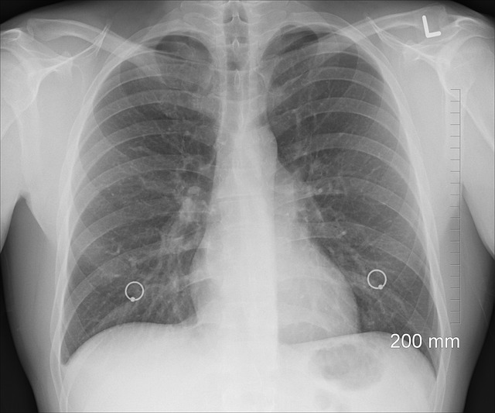
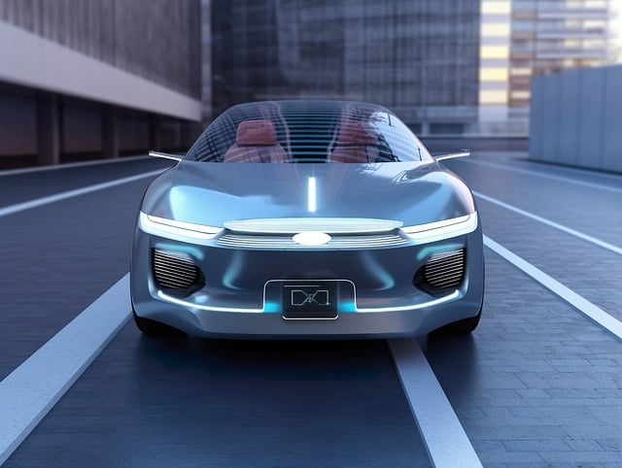
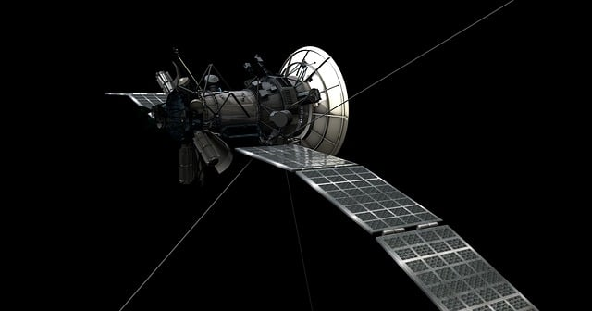
Why Tiny/EdgeML?
Increased privacy / regulations
Real-time systems
Low bandwidth
Saves energy and compute!

Slide 3
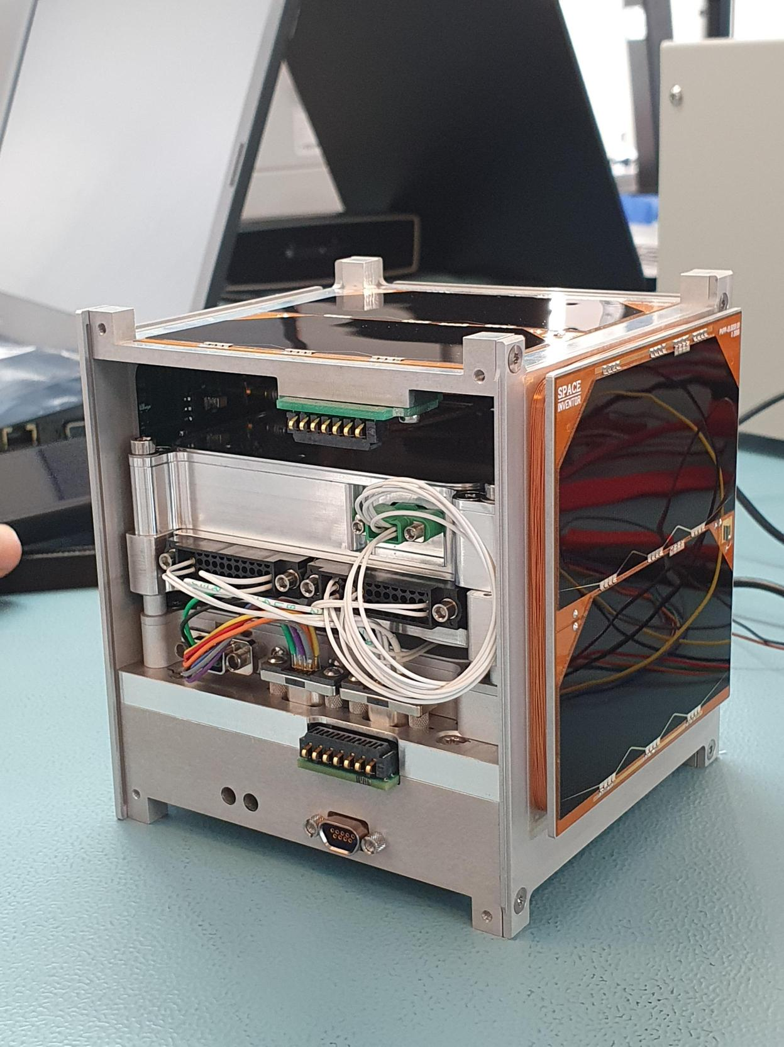
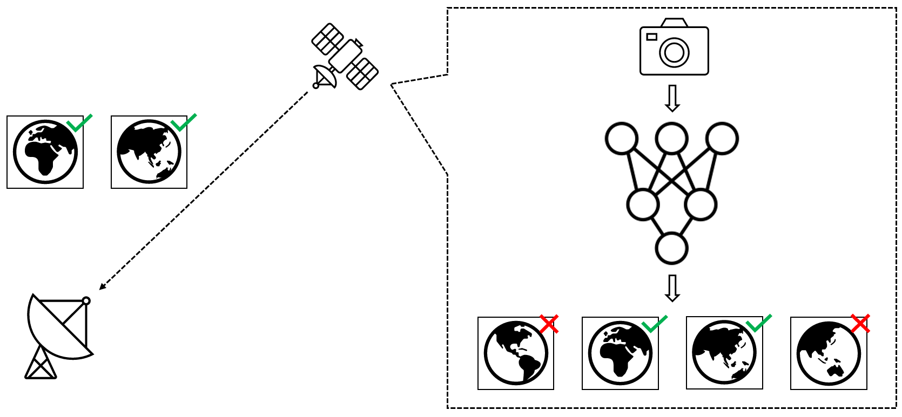
Example Use Case – Satellites!
DISCO 1&2
Small Earth-observation satellites
Very low network bandwidth
Produces large amount of data

Slide 4
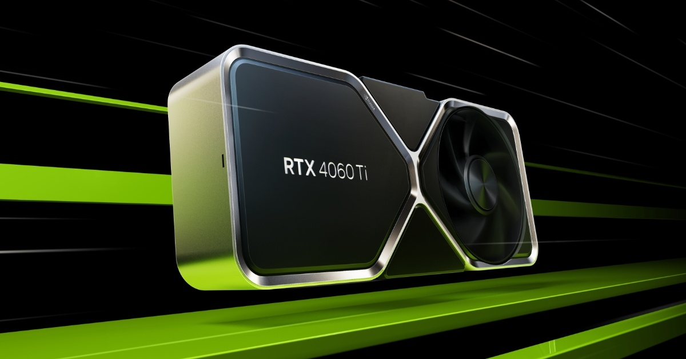
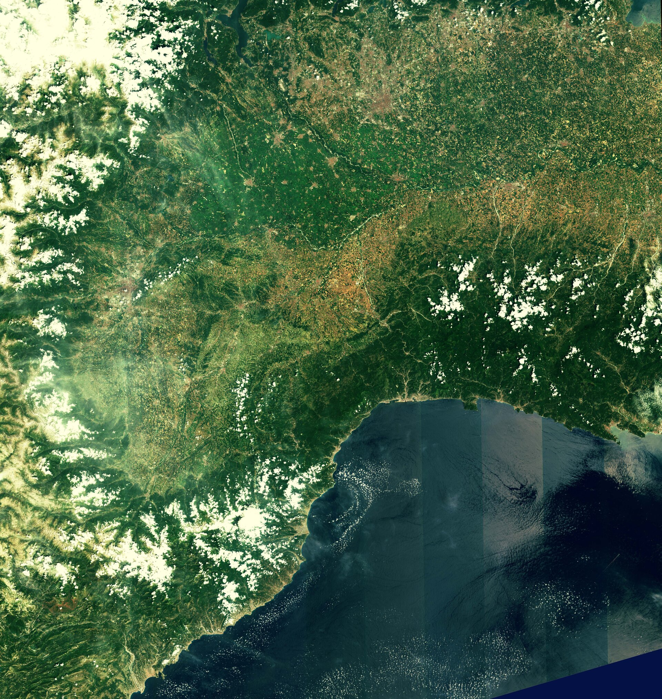
Machine Learning on Satellites
Challenges
Low power budget (2 W avg, 5 W max)
Low latency requirements (4.42 s / image)
Need for robustness and flexibility
4512px
4512px
NVIDIA RTX 4060 115W TDP
Source: NVIDIA

Slide 5
TinyML Hardware Landscape
Microcontrollers / CPUs​
+ Low power footprint​
- Low degree of specialization​
- Low degree of parallelism ​
Edge SoCs + GPUs​
+ High degree of parallelism​
- High power footprint​
ASICs​
+ High degree of specialization​
+ High degree of parallelism​

Slide 6
Looking for the Best Candidate
Low power draw ≠ high efficiency
Highest degree of specialization necessary

Slide 7
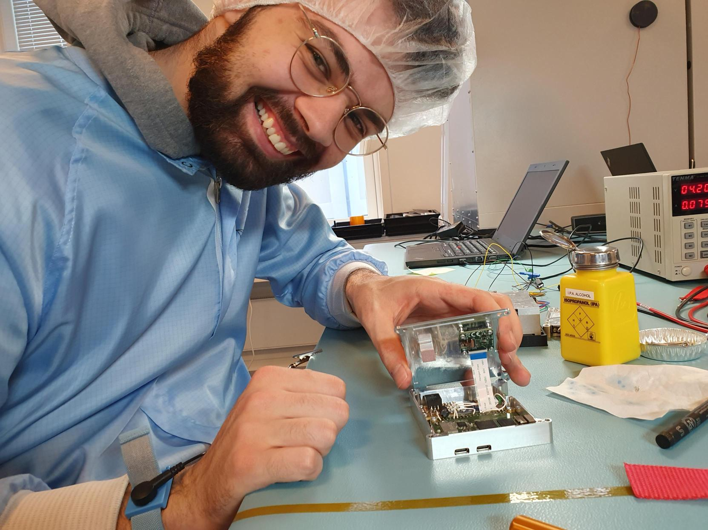
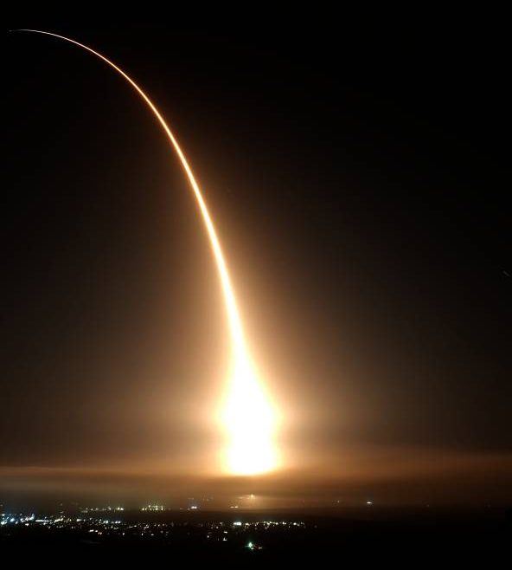
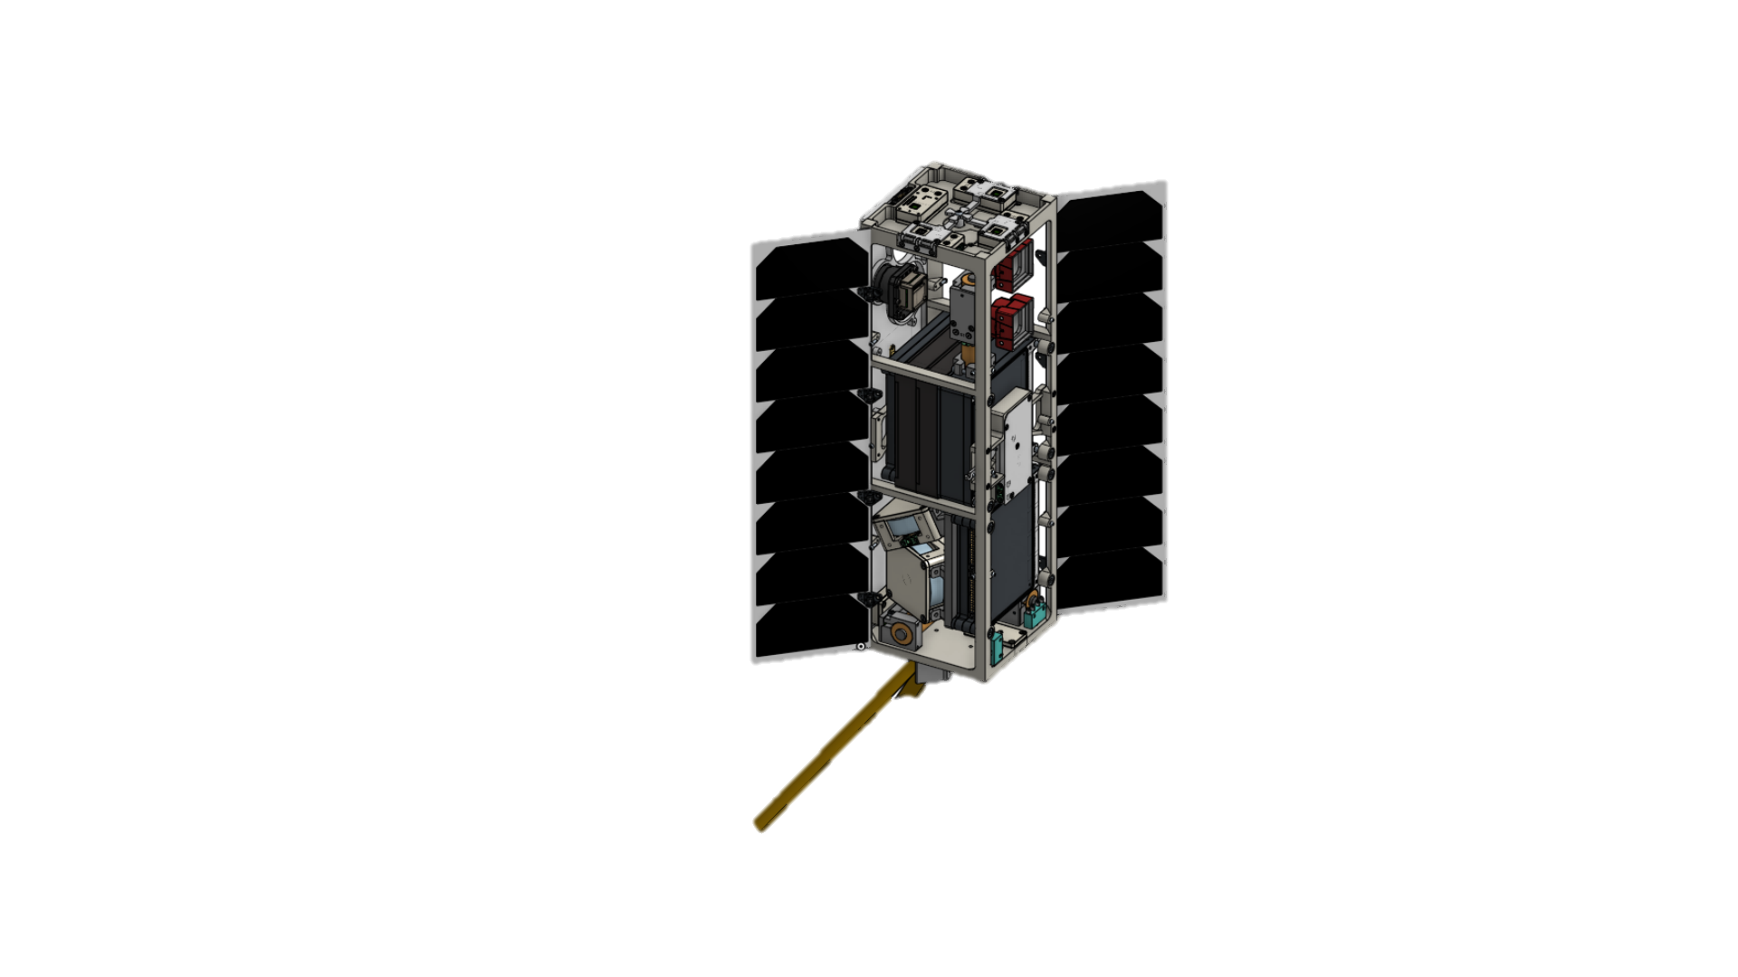
Results
Designed image processing unit based on CoralAI Dev Board Mini
DISCO 1 launched in April 2023
Currently working on DISCO 2

Slide 8
Current & Future Research
Need for standardized benchmarking
Would save us a lot of time
Standardized benchmarks too small or too big
Resource management
Co-location of multiple tasks
Task placement

Slide 9
Thank you!
Q&A

