Slide 1
Modelling the performance of delivery vehicles across urban micro-regions to accelerate the transition to cargo-bike logistics
Max Schrader • Navish Kumar • Akash Srivastava • Kai Xu • Esben Sørig • Soonmyeong Yoon• Nico Collignon • Maria Astefanoaei

Slide 2
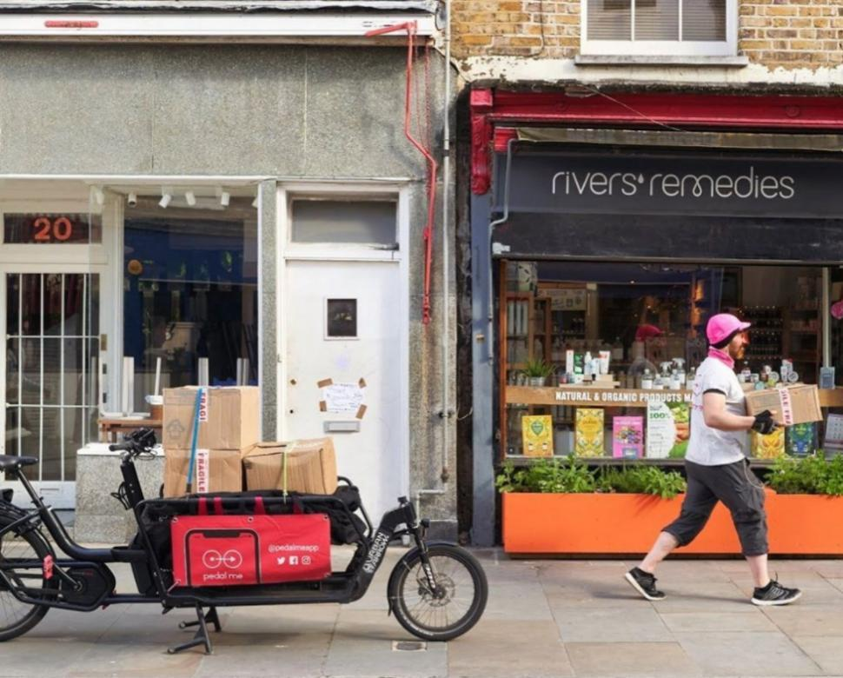
Motivation
The amount of CO2 emissions and traffic congestion caused by urban last-mile deliveries is estimated to increase 30% by 2030¹
In urban settings, there is a better solution: cargo bikes!
A study found that 67% of daily van operations of a large logistics operator in Paris could be substituted by cargo-bikes at no extra cost²
In the Netherlands, DHL already makes 60% of inner-city deliveries by cargo bikes.
PedalMe cargo-bike in London (project partner)
The future of the last-mile ecosystem. In World Econ. Forum, volume 1, pages 1–28, 202
First and last miles by cargo bikes: Ecological commitment or economically feasible? the case of a parcel service company in paris. Transportation Research Record
Notes:
This is exacerbated by ecommerce. By 2025, the number of packages delivered around the world is expected to climb to 200 billion, up from fewer than 90 billion in 2018
Recently, cargo bike logistics has been put forward as a competitive, zero-emission candidate for replacing LGVs
They cut pollution, decongest cities, emit a tenth of the CO2 emitted by an electric van, and take much less space on the roads, all this while moving significantly faster in dense urban areas.
Due to their faster speeds, shorter parking times, and more efficient routes across cities, they can out-compete traditional van logistics when operated effectively.
in urban areas, experts usually estimate that cargo bikes can replace 25-50% of van deliveries.
Transport for London estimated up to 14% of vans could be replaced by cycle freight by 2025 in areas where LGVs contribute to more than 60% of traffic.
In the Netherlands, DHL already makes 60% of inner-city deliveries by cargo bikes.
In Paris, up to 67% of operations could be replaced

Slide 3
Transitioning to Cargo Bikes
We need a Model
Legacy companies in LML operate on tight margins / high pressure
They need a model that captures the complexity of driver (and rider) behaviour to convince them of the performance of cargo-bikes
5.8 min in Seattle¹
24 min in NYC²
62% of total time in London³
Total Delivery Time
Service Time
Travel to Destination
Cruising for parking
Unloading Parcels
Walking to Destination
Do commercial vehicles cruise for parking? Empirical evidence from seattle. Transport Policy, 97:26–36, 2020.
Impacts of freight parking policies in urban areas: The case of new york city. 2016
Understanding the impact of e-commerce on last-mile light goods vehicle activity in urban areas: The case of london. Transportation Research Part D: Transport and Environment, 61:325–338, 2018.
Notes:
While the effectiveness of cargo bikes as been shown in several studies and pilot programs by DHL, legacy companies need to be convinced of the competitive advantages
They work on tight margins and under high pressure and make data driven decisions
They need a cost-effective way to compare van performance to cargo bikes. Prior models are too simplistic, and don’t capture the variability in driver and rider behaviour.
The goal of this project is to model the delivery time of the two modes, so that van & bike performance can be compared,
Delivery time is comprised of travel time & service time, and this specific presentation focuses on service time
Which is a composition of time cruising for parking, unloading parcels, and walking to the destination, and applies regardless of whether bike or van
Cruising for parking can take a significant amount of time in cities, with two cities finding...
Walking to the destination can also be quite time consuming, taking 62% of the time in London

Slide 4
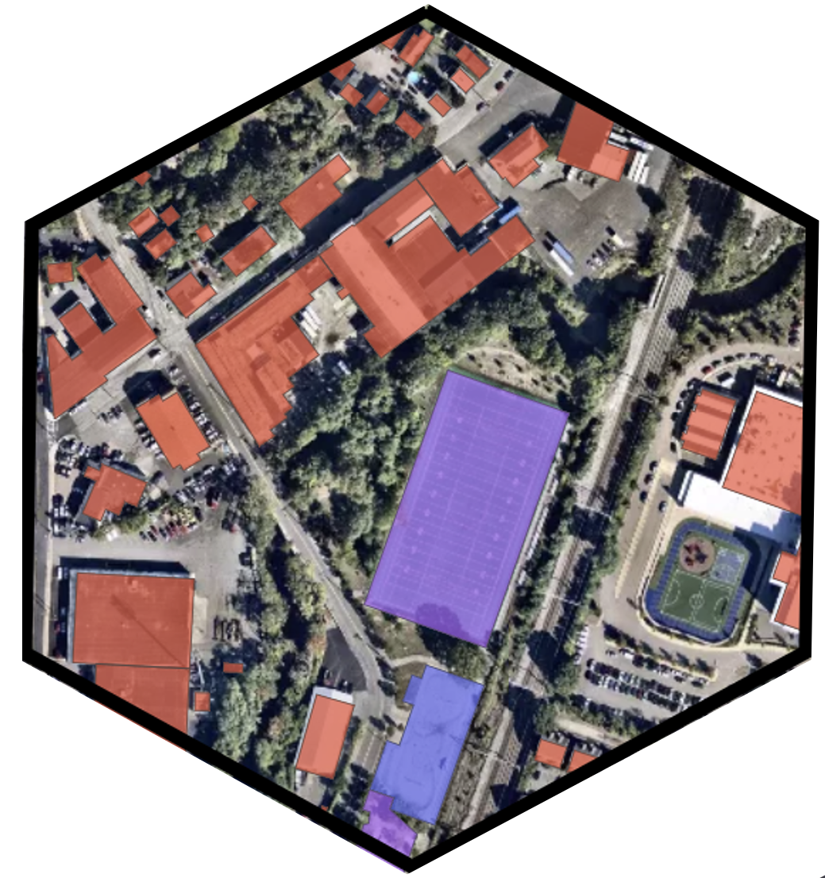
Service Times as a Function of Urban Context
Dividing the City into Micro-Regions
Using Uber H3 to tessellate space into hexagons
Using OpenStreetMap tags as descriptors
More than 1000 key:value pairs
We aim to predict the distribution of service times inside an H3 cell
Cell mean times should be transferable and less influenced by package characteristics
Intra-cell variance is high, meaning it is important to understand not just the mean, but also the variance
892a3064b3bffff
building:yes | sport:american_football | amenity:parking
39 | 1 | 1
174.4 meters
Notes:
We aim to model the service times as a function of urban context, because package-level (height, weight, #, etc) can vary across data providers, and address-level information has privacy concerns.
By urban setting, we mean high population density, concentration of administrative bodies and infrastructure and a diverse set of livelihood and income generation activities.
To capture a delivery’s surrounding urban context, we use Uber H3, which tesselates the globe into hexagonal cells
Uber H3 cells as it is applied indiscriminately everywhere, instead of localized divisions such as zip code or neighborhood boundaries
Aids in transferability without knowing the specifics of the place!
Once the space is split into hexagons, we use Openstreetmaps API to pull data and count the category occurrences in the hexagon
It has >1000 sub categories
We have found the best hexagon cell size to be resolution 9, with an average side length of 174 meters
The image to the left displays the process

Slide 5
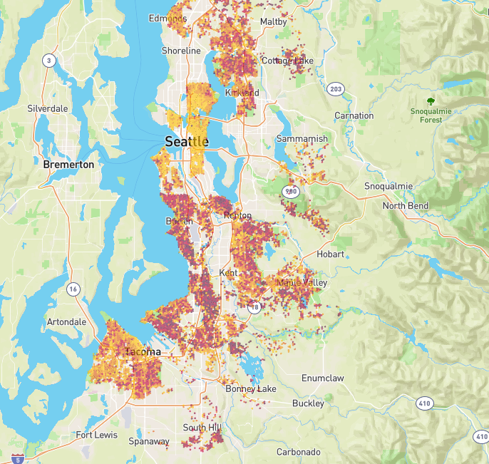
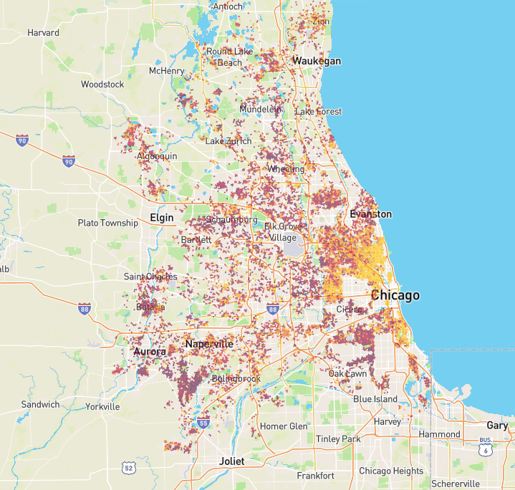
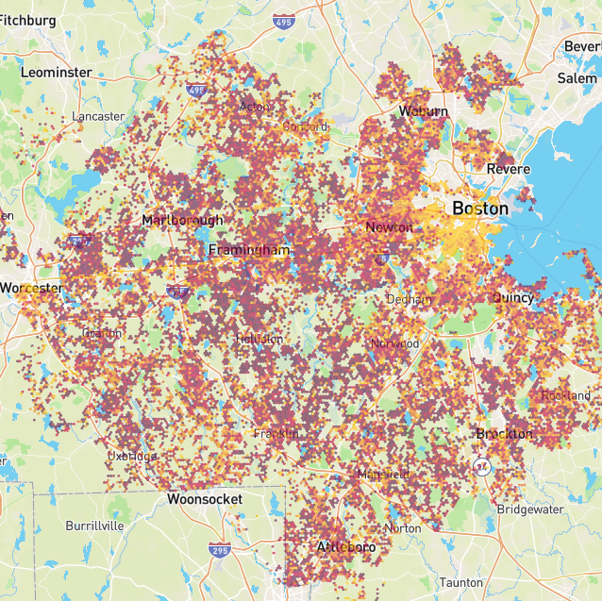
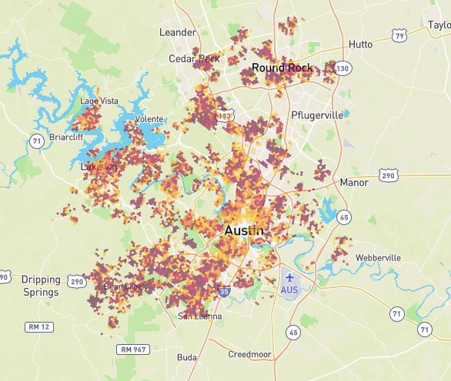
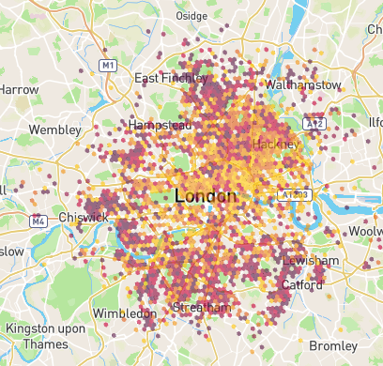
Datasets
Van
Amazon Delivery Dataset¹
5 US Cities
6,112 Driver Routes
56% of time spent is service time
896,242 Deliveries
1.8 minutes of service time per stop
Cargo-bike
(London, UK)
100 Bikes
~30,000 Deliveries
(Brussels, BE)
Seattle
Chicago
Boston
Los Angeles
Austin
London
1 https://github.com/MIT-CAVE/rc-cli/blob/main/templates/data_structures.md
Notes:
Amazon dataset is anonymized so we don’t know the exact delivery location but an approximate location around it.
Amazon Service Time comes from their internal model and is not empirical
For London dataset the true service times are calculated based on the time difference when the rider comes in contact with the biofence and when he himself declares the completion of delivery via the app.

Slide 6
Preliminary Results
Using NGBoost¹, we perform variational regression for service times
The containing H3 cell tag counts are the feature vector for a delivery
Testing on Boston (5-FOLD CV), w/ 35, 442 deliveries in 1197 hexagons w/ 674 OSM Tags.
mean NLL of 3.51 (SD = 1.23) and
mean R2 value of 0.55 (SD = 0.08).
Most important features are coherent with characteristics of urban space. For e.g.,
presence of parking, the type and density of buildings, or the type of roads.
https://dl.acm.org/doi/abs/10.5555/3524938.3525190
Standard Deviation
Notes:
The fact that features that are deemed important are also the ones that one would think are relevant proves that our approach and high level methodology is correct!
The variance prediction is important because that highlights the importance of urban environments and type of vehicle performing the delivery. As we hope to see a clear difference in the predicted variance for service times across H3 cells between cargo bikes and vans!

Slide 7
Roadmap
Build a ML model that is generalizable across multiple cities
Compare different H3 resolutions between the variability in service and navigation time predictions for cargo bikes vs vans
Cargo bikes have less variability between urban regions than vans!
We plan on releasing datasets with the OSM tag features added, to prompt future modelling efforts.
Notes:
Generalizability here means that if we train our model on most of the most dense cities of the US, say Boston, then we would be able to transfer the learning to an another dense city elsewhere, say London. City with similar urban context should have similar service and navigation time predictions.
Variability in predictions for Vans will be higher because of the aforementioned reasons, i.e., traffic congestion, hard to find parking, time of the day etc

