Slide 1



DECOUPLING IT?
A Global Comparative Ethnography of the Role of IT in the Mitigation of the Climate Crisis
Notes:
Thanks to Martin from communications for the layout on these slides – also our CCIT tree!

Slide 2
WHAT KIND OF CHANGE IS DECOUPLING?
THE ‘REGULAR’ APPROACH:
DECOUPLING AS ECONOMIC GROWTH VS RESOURCE USE
What are the economic/growth assumptions involved?
What are assumptions about change?
Economic Growth
Climate Impact

Slide 3


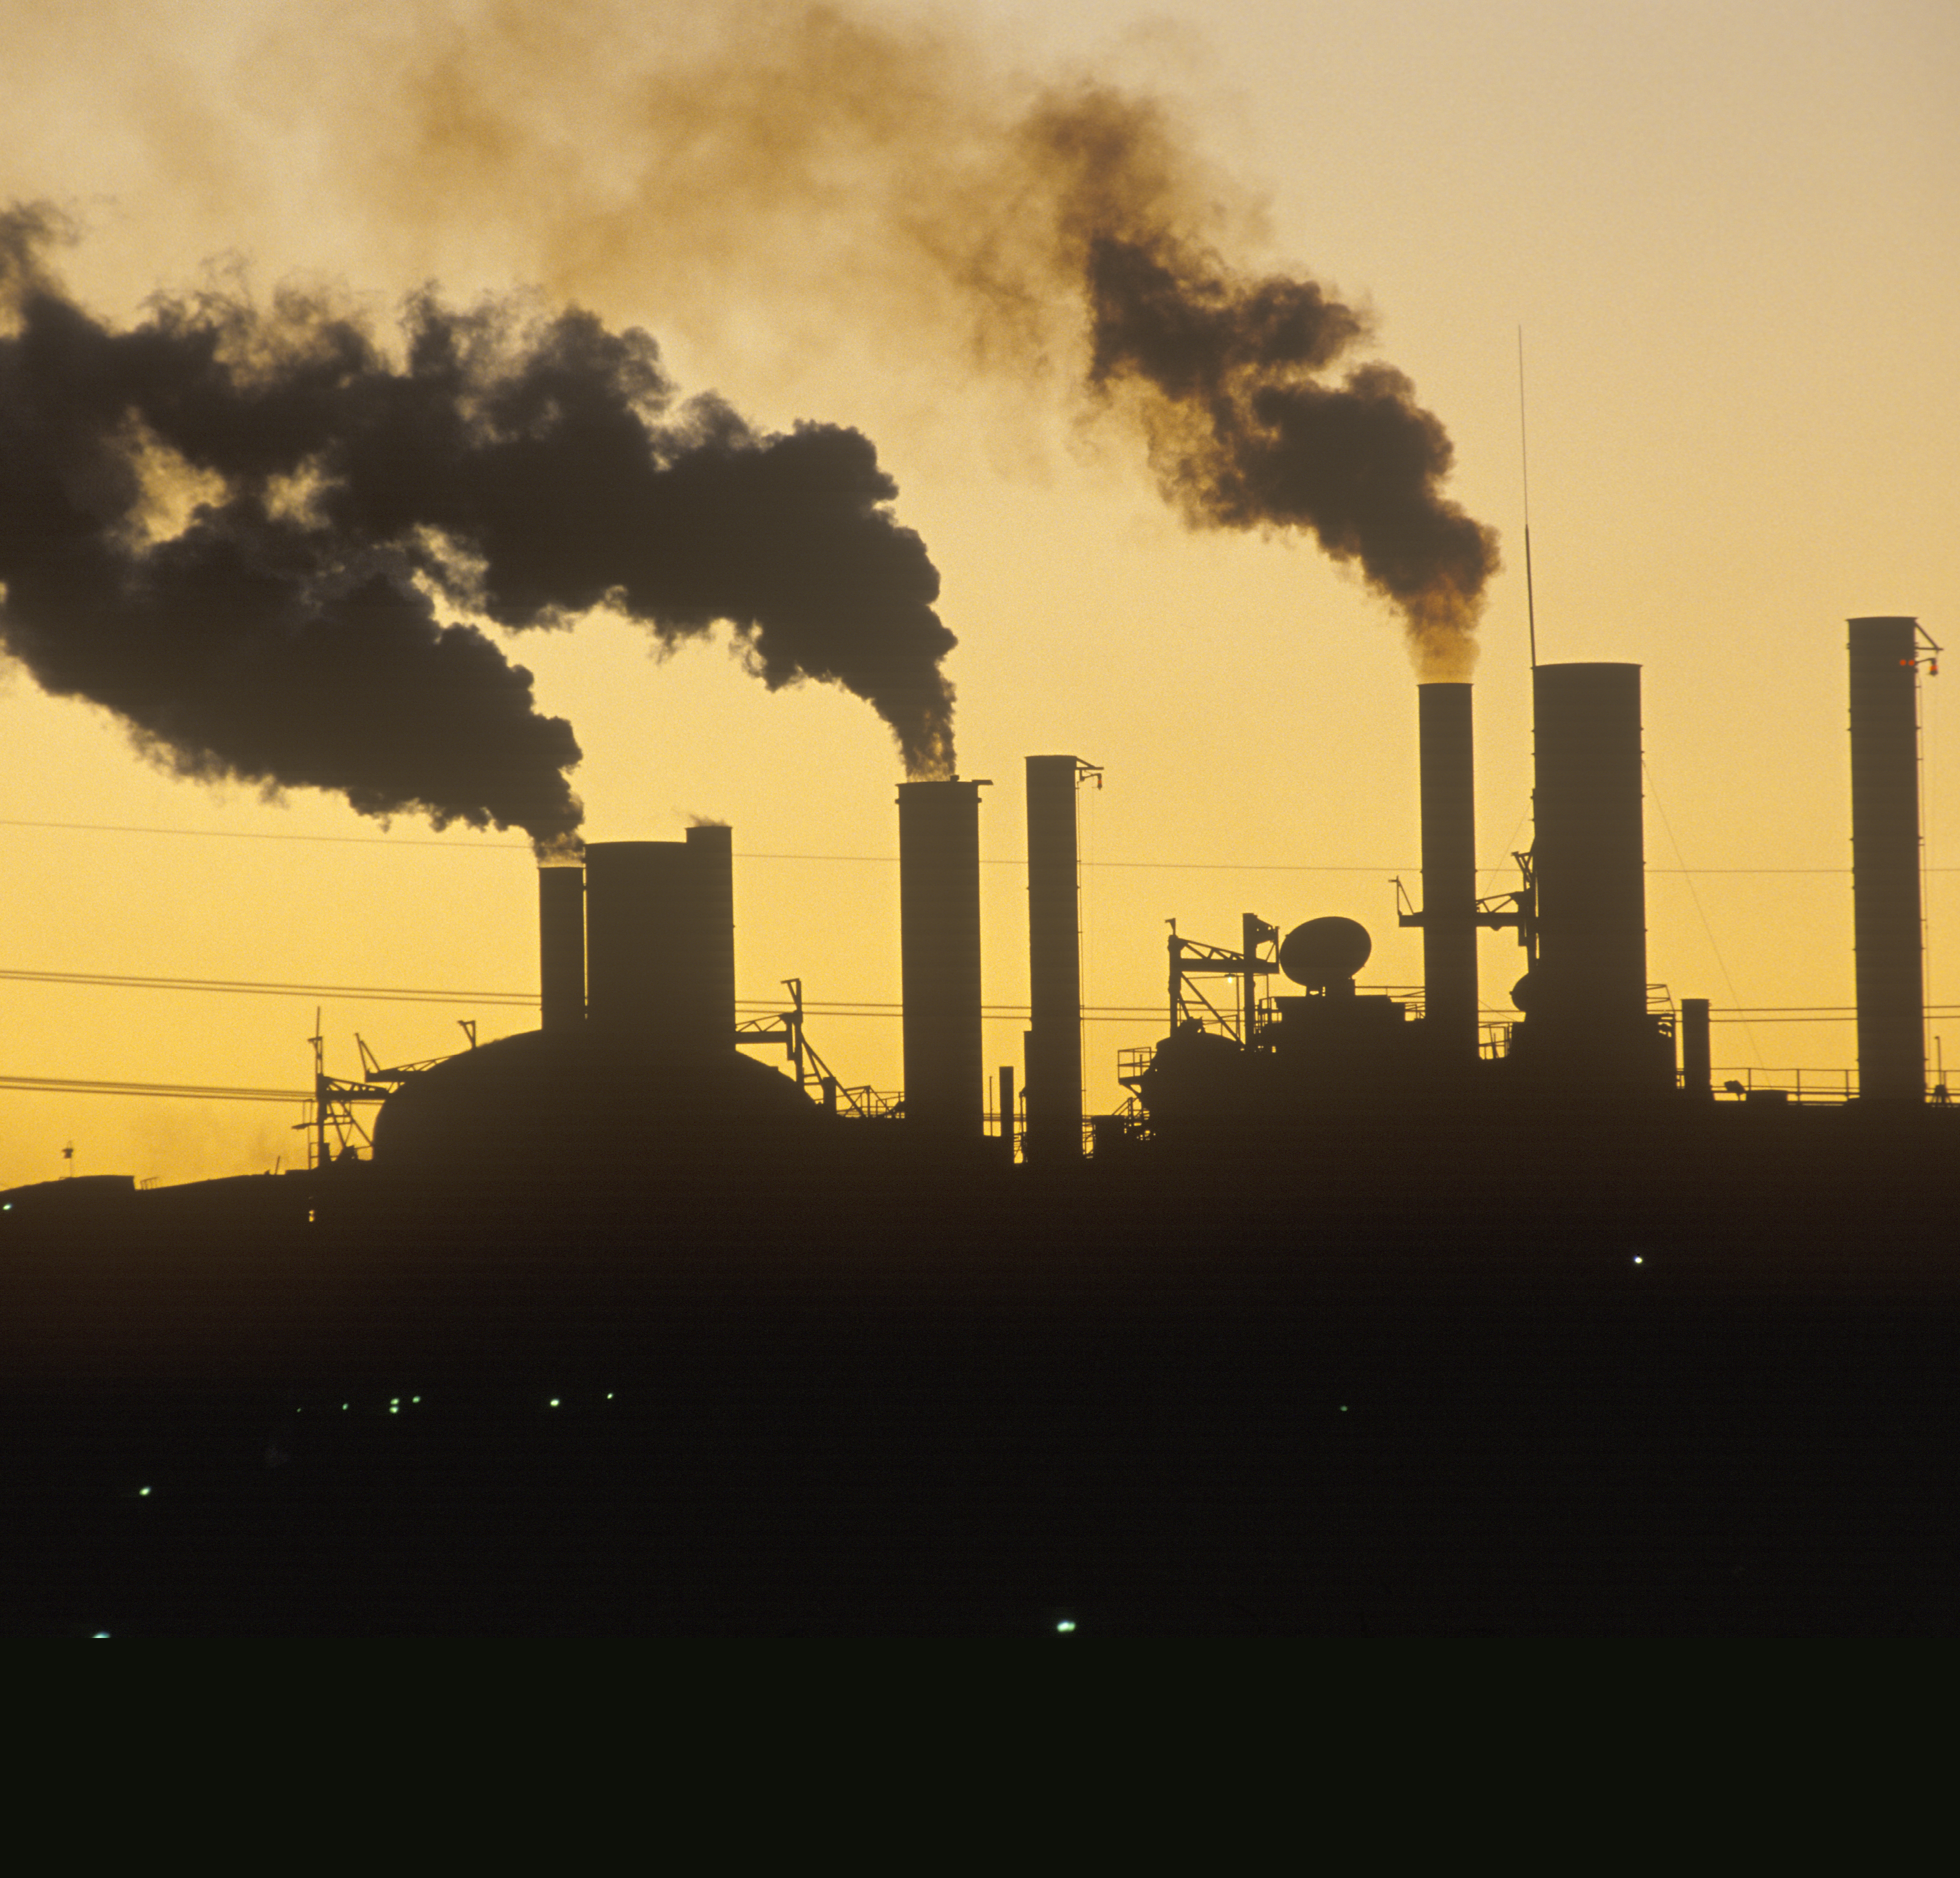

WHAT KIND OF CHANGE IS DECOUPLING?
OUR APPROACH:
DECOUPLING AS SOCIOCULTURAL CHANGE
Addressing four assumptions about change and its cultural dimensions in relation to decoupling:
Subjectivity
Reflexivity
Agency and responsibility
Continuity
IT
Economy
Climate Change

Slide 4
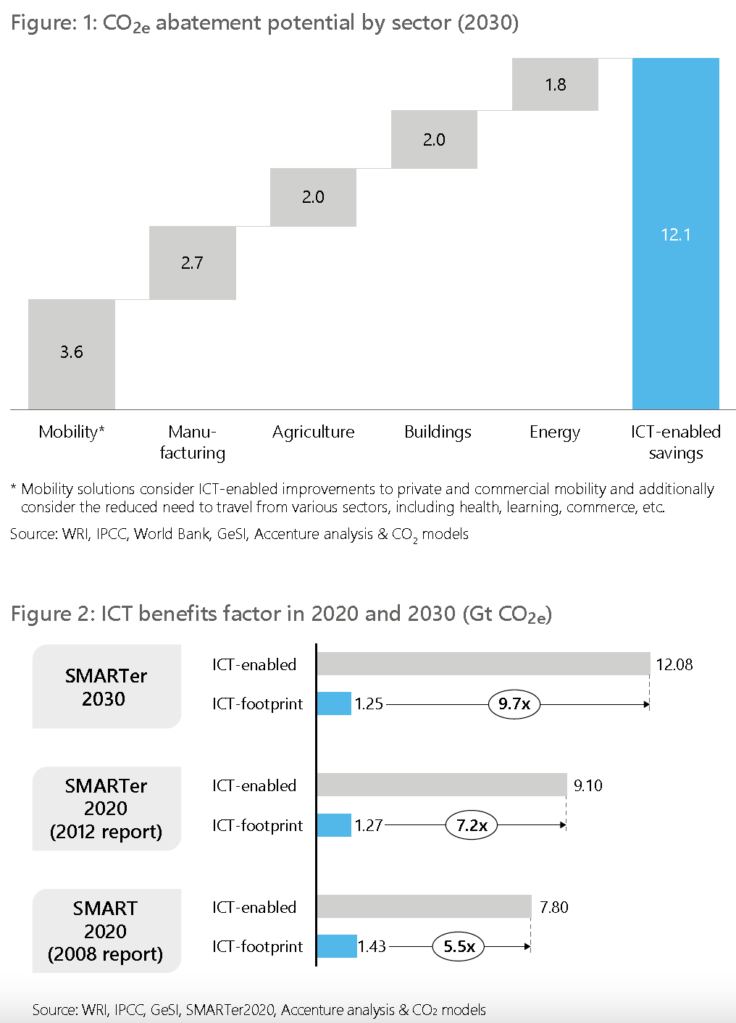
THE IMPACT OF THE IT SECTOR (2015)?
Contrasting narratives of the role of IT
IT as ‘the good guy’
IT as ‘the bad guy’

Slide 5











SUBPROJECTS: CLIMATE-IT-HUBS
Iceland
China
Bangladesh
Ahsan
Santos da Costa
Maguire + Figueiredo
Wang + Wei Guo
Dalsgaard
Hansen
Kenya
Brazil
South Africa

Slide 6
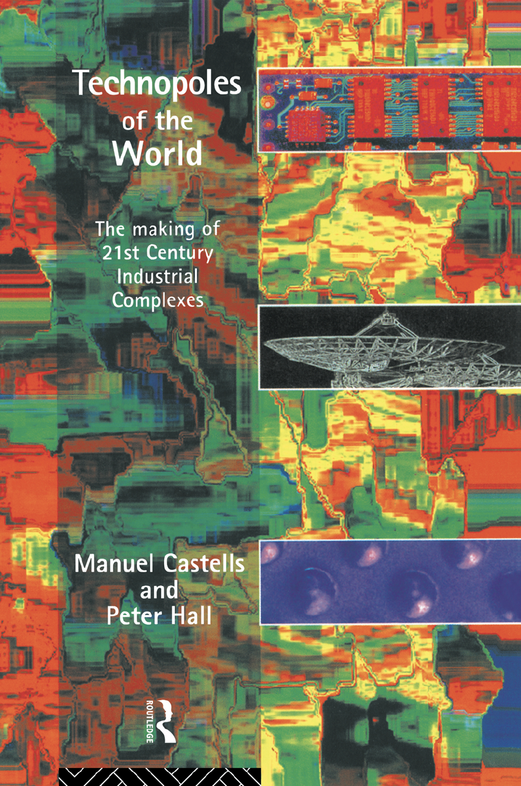
CONCEPTUALISING THE RESEARCH CONTEXTS
“Far from Silicon Valley” …
Sites with distinct climate impacts (and distinct expectations to their mitigation)
Sites with distinct promotion of technological development, entrepreneurship etc.

Slide 7

EXAMPLE: SILICON SAVANNAH
Digital wells to deal with water scarcity
Digital waste sorting – plastics but also imported (digital) waste
Carbon sequestration organised through blockchain and paid by offsets
Incubators of ‘cleantech’ start-ups supported by government funds but also (Danish) development funds as ‘TechVelopment’
Geothermal energy extraction in Rift Valley (with Icelandic expertise)
Infrastructure development including fibre optic cable and Chinese-funded Huawei data center
Konza Technopolis (‘smart city’)
Kenya
Nakuru
Nairobi

Slide 8

EXAMPLE: SALVAGE TECHOSCIENCE IN BRAZIL
Imaginaries of the Amazon give rise to specific approaches to its ‘salvation’
Tech-based (e.g. blockchain tokens)
External (driven by science and tech-industry entrepreneurs – no or fragmented local participation)
Distant (often through satellites,different types of sensors)
Growth-based (increase production and extraction of resources from the forest)
Brazil
Belem
Transamazônica Highway
Notes:
But salvation from who or what? (illegal mining, poor illegal settlers? Or capitalist world markets driving the extraction?)

Slide 9

AMBITIONS
EXPECTED CONTRIBUTIONS
Anthropological understanding of IT-based approaches to (climate) change in practice.
Expanding the conceptual horizon of the qualitative social science of IT
Exploration of the sociocultural interrelation of IT, climate change and contemporary capitalism.
BROADER IMPLICATIONS
Understanding IT-based responses to climate change as a matter of generating sociocultural change.
Addressing the climate impact of the IT sector.

