Slide 1
Sustainability Reporting & IT
Michael Hockenhull, Postdoc, Department of Business IT
CCIT Seminar
11/12-2023

Slide 2
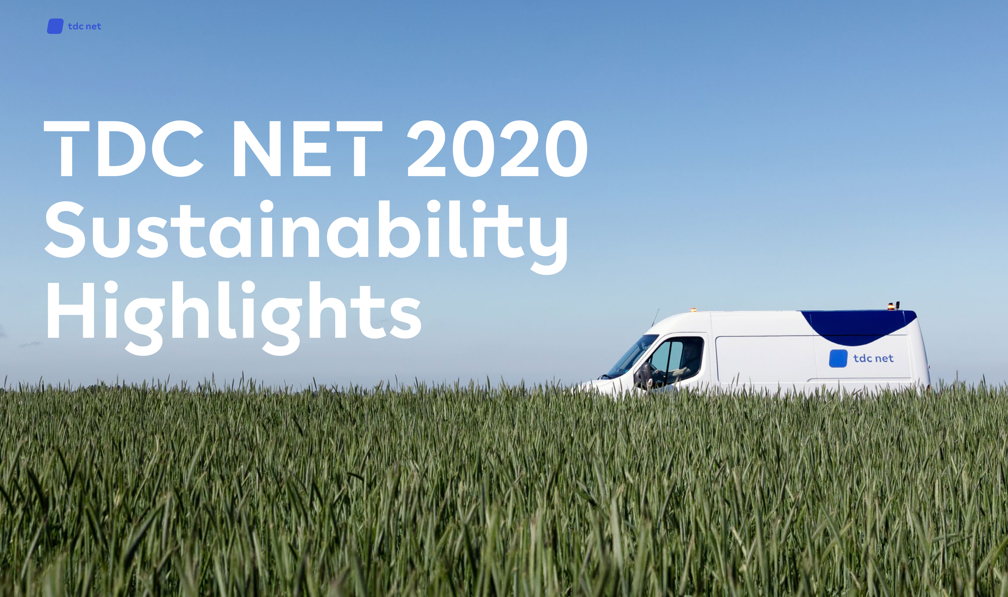
What is sustainability reporting?
Sustainability reporting (SR) refers to corporate public disclosure of information relating to the sustainability of their activities understood in the broadest sense
Also known as or related to ESG (Environmental, Social, Governance)-reporting, Corporate Social Responsibility (CSR), SDG Communication on Progress (CoP), etc.
Typically a voluntary or loosely regulated type of reporting, and thus subject to widespread critique of constituting greenwashing (de Freitas Netto et al., 2020; Gray, 2010; Moodaley & Telukdarie, 2023)
Per 2024 the European Corporate Sustainability Reporting Directive (CSRD) will require large companies to report on up to 70 different quantitative indicators

Slide 3
Why care about sustainability reporting?
Climate transition is largely still predicating on a market-based approach (Eaton, 2021)
Markets require improved information signals to select the more climate-friendly/sustainable solution
SR represents an attempt to provide such information signals, internalizing traditional externalities such as emissions into pricing
Despite risks of greenwashing, SR is a critical mechanism for the financing of the green transitions

Slide 4
How does sustainability reporting connect to IT?
IT as tool for study and critique of SR
IT as fundamental to SR role in green financing
IT role in corporate response to increased demands

Slide 5
How does sustainability reporting connect to IT?
SR has historically been made via unstructured data (pdfs, scanned documents, company websites) and relies on complicated processes of data collection
IT approaches (machine learning, NLP, web scraping, critical data studies) as a way to understand, scrutinize, study and make corporate reporting accountable (J. Bingler et al., 2022; J. A. Bingler et al., 2022; Grenestam, 2022; Kitchin & Lauriault, 2014)
Role of SR means pressure to streamline and integrate reporting practices via digitalization
IT infrastructure and data governance (XBRL, api-exchanges) as fundamental for the future of sustainability reporting practices (Wang et al., 2022; Hockenhull, forthcoming)
CSRD reporting demands of companies leads to compliance pressures (Bach, 2023; Funch, 2023; Raun, 2022)
IT as a way for corporations to meet increasing reporting requirements (regulatory and voluntary) via new systems for data collection and management (Lombardi & Secundo, 2020; Seethamraju & Frost, 2019)

Slide 6
Summary
SR is a widespread corporate practice of disclosing sustainability information to the public
SR plays a critical role in a (still dominant) market-based approach
IT plays an equally critical and intensifying role in SR:
IT as tool for study and critique
IT as fundamental to SR role in green financing
IT role in corporate response to increased demands
More research into this highly interdisciplinary area is sorely needed!
Thank you for your attention!!

